Slide 1

ADVANCED DATABASE MANAGEMENT PROJECT
Final Project for Advanced Database Management System (ISM6218)
Presented by:
Vijaya Kumar Gavidi
Jaswanth Buggana
Sai Kumar Kanna
Sumanth Reddy Bajjuri
Ravi Varma Allani

Slide 2
PURPOSE
HOTEL MANAGEMENT SYSTEM
Topic Area | Description | Group Member | Weight
Database Design | Logical database design (for the relational model) | Vijaya Kumar Gavidi Ravi Varma Allani | 30%
Query Writing | Writing SQL queries Explore transactions Database programming for stored procedures. | Vijaya Kumar Gavidi Sumanth Reddy Bajjuri | 25%
Performance Tuning | Indexing optimizer modes Partitioning parallel execution any other techniques | Jaswanth Buggana | 20%
DBA Scripts | Data visualization Exploring any other topics of interest | Sai Kumar Kanna | 25%

Slide 3

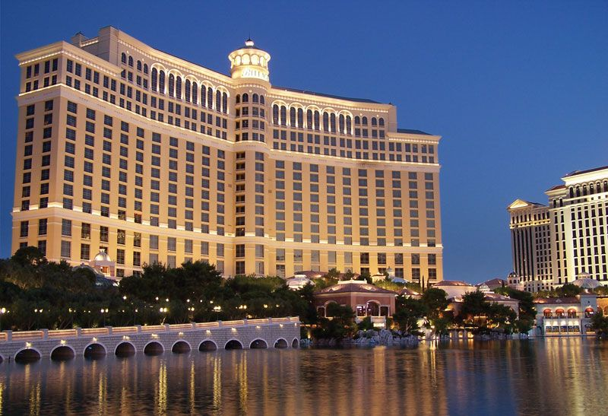
Narrative
A hotel has several entities involved like customers, rooms, bookings, services
Digitalization of the information for greater strategic planning, faster administration, managing the relationship between customers, employees and the management, and offering more services in the future.
Unique customer ID is provided whenever a new customer books a reservation
Each Customer can book multiple reservations.
Entities Identified:
Customer
Room
Booking
Services
Reservations
Line
Transactions
Satisfaction
Address
Invoice

Slide 4
Entities Attributes
Customer:- | customer_id (primary key) first_name last_name Gender phone_number
Booking:- | Booking_id (primary key) Book_type Book_date Customer_id (Foreign key from Customer)
Reservation:- | Res_id (primary key) check_in_date check_out_date (number of days) No_of_days Customer_id (Foreign key from Customer) Booking_id (Foreign key from Booking)
Room:- | Room_no Room_type Bed_type No_of_occupants Room_price Customer_id (Foreign key from Customer) res_id (Foreign key from Reservation)

Slide 5
Address:- | Street City State Country Customer_id (Foreign key from Customer) Zip_code
Services:- | Service_id (primary key) Service_type Service_cost
Invoice:- | Invoice_No (Foreign key from Invoice) Service_id (Foreign key from Services) Service_quantityy res_id (Foreign key from Reservation)
Line:- | Invoice_No (Foreign key from Invoice) Service_id (Foreign key from Services) Service_quantityy res_id (Foreign key from Reservation)
Transaction:- | Trans_No (primary key) Payment_Method Payment_Date Invoice_no (Foreign key from Invoice) Customer_id (Foreign key from Customer)

Slide 6
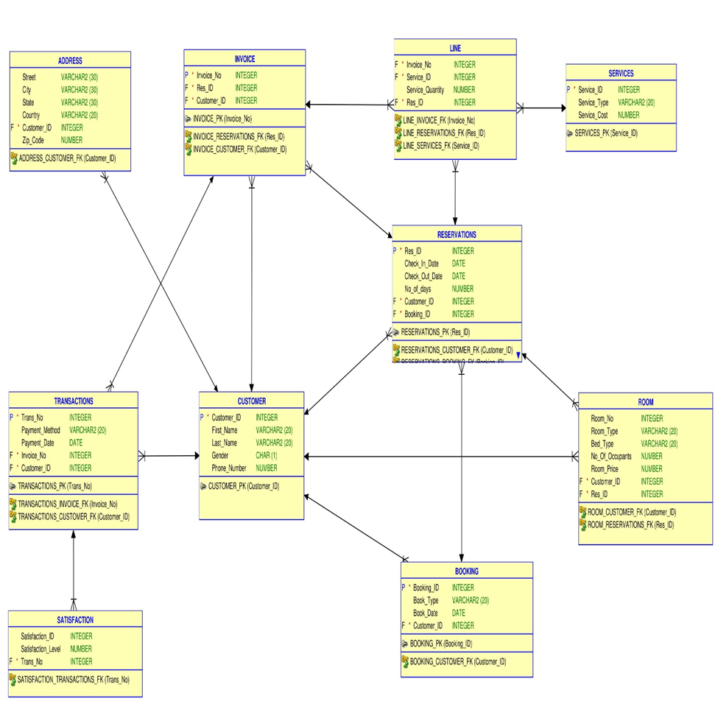
Satisfaction:- | Satisfaction_ID Satisfaction_level Trans_no (Foreign key from Transactions)
Entity Relationship Diagram

Slide 7
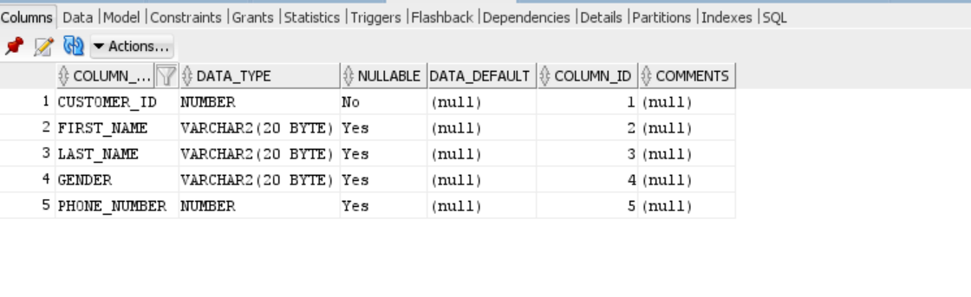
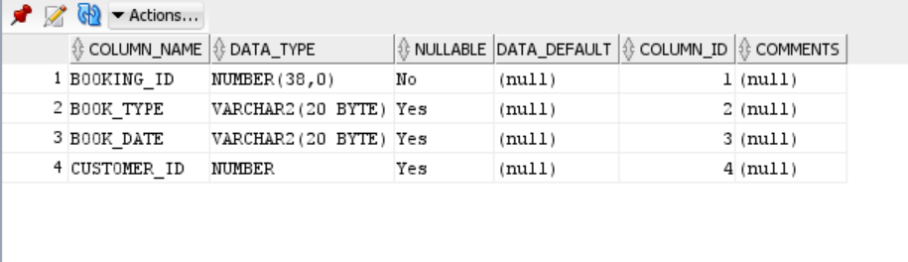
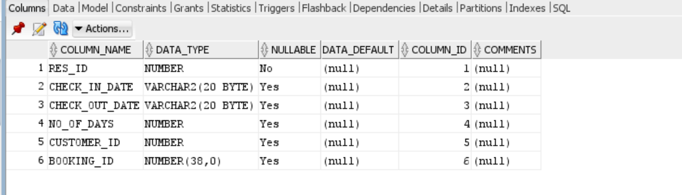
Table Views

Slide 8
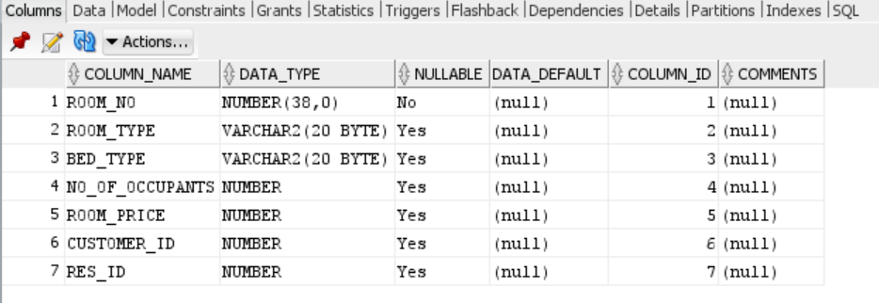
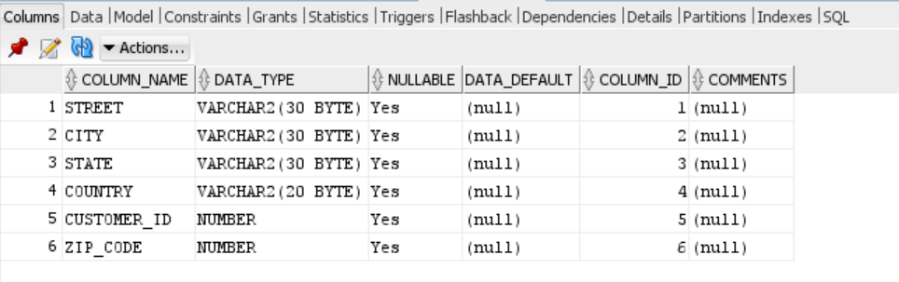
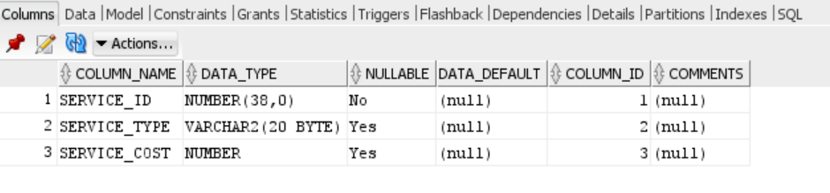

Slide 9
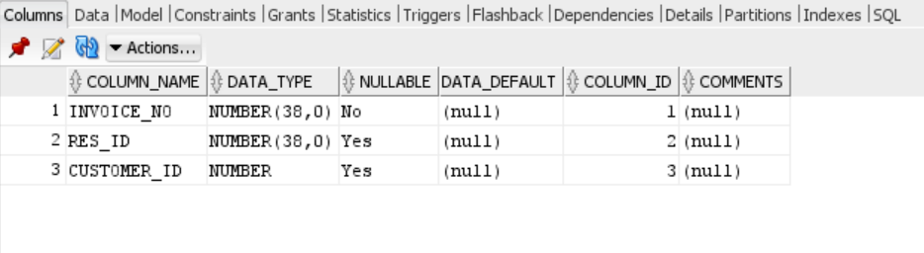
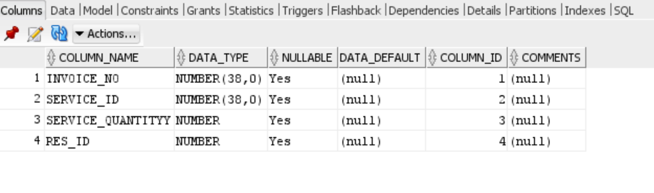
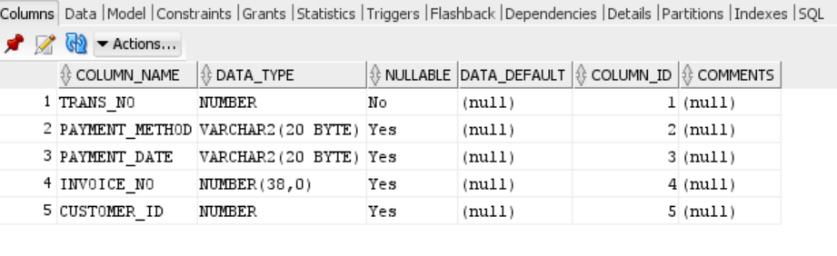

Slide 10
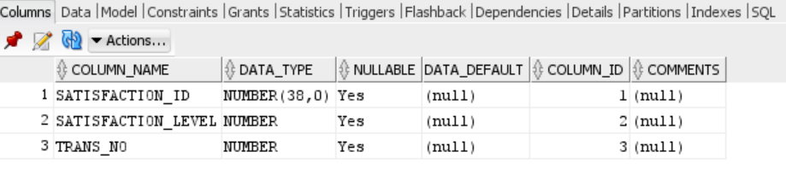

Slide 11
Data Generation and Data Integrity
Some common integrity constraints
NOT NULL – Prevents a column from having a NULL value.
PRIMARY KEY – Uniquely identifies each row or record in table.
FOREIGN KEY – Uniquely identifies a column that references a PRIMARY KEY in another table.
UNIQUE – Prevents a column from having duplicate values.
CHECK – Checks for values that satisfy a specific condition as defined by the user.

Slide 12
Below are some of the constraints that we have enforced in our data base design
Table containing Customers | CREATE TABLE customer ( customer_id number NOT NULL primary key, first_name VARCHAR2(20), last_name VARCHAR2(20), Gender VARCHAR2(20), phone_number NUMBER );
Table containing Bookings | CREATE TABLE Booking ( Booking_id INTEGER NOT NULL primary key, Book_type VARCHAR2(20), Book_date VARCHAR2(20), Customer_id number , FOREIGN key(customer_id) references customer );
Table containing Reservations | CREATE TABLE Reservation ( Res_id number NOT NULL primary key, check_in_date varchar(20), check_out_date varchar(20), No_of_days number, Customer_id number , Booking_id INTEGER, FOREIGN key(customer_id) references customer, FOREIGN key(booking_id) references booking );

Slide 13
Table containing Rooms | CREATE TABLE Room ( Room_no INTEGER NOT NULL , Room_type varchar(20), Bed_type varchar(20), No_of_occupants number, Room_price number, Customer_id number , res_id number, FOREIGN key(customer_id) references Customer, FOREIGN key(res_id) references Reservation);
Table containing Addresses | CREATE TABLE Address ( Street varchar(30), City varchar(30), State varchar(30), Country varchar(20), Customer_id number , Zip_code number, FOREIGN key(customer_id) references Customer );
Table containing Services | CREATE TABLE Services ( Service_id INTEGER NOT NULL primary key, Service_type varchar(20), Service_cost number );
Table Creating Invoices | CREATE TABLE Invoice ( Invoice_No INTEGER NOT NULL primary key, Res_id integer, customer_id number, FOREIGN key(res_id) references reservation, FOREIGN key(customer_id) references Customer );

Slide 14
Table Creating Line Details | CREATE TABLE Line ( Invoice_No INTEGER , Service_id integer, Service_quantityy number, res_id number, FOREIGN key(Service_id ) references services , FOREIGN key(Invoice_No) references invoice , FOREIGN key(res_id ) references reservation );
Table Creating Transaction Details | CREATE TABLE transactions ( Trans_No number NOT NULL primary key, Payment_Method varchar(20), Payment_Date varchar(20), Invoice_no integer, Customer_id number, FOREIGN key(invoice_no) references Invoice, FOREIGN key(customer_id) references Customer );
Table Creating Transaction Details | CREATE TABLE Satisfaction ( Satisfaction_ID INTEGER, Satisfaction_level number, Trans_no number, FOREIGN key(Trans_no) references Transactions );

Slide 15
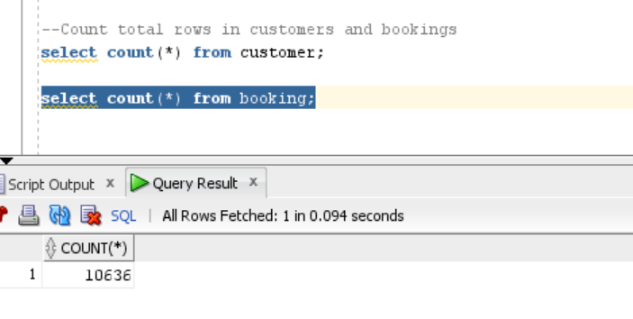
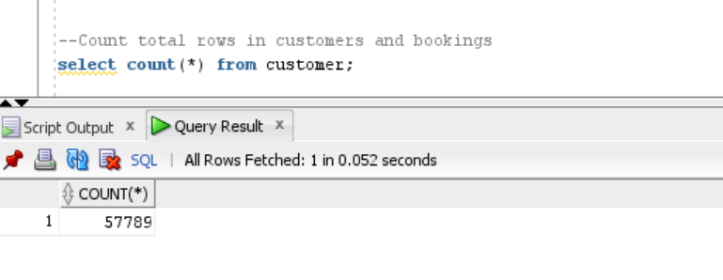
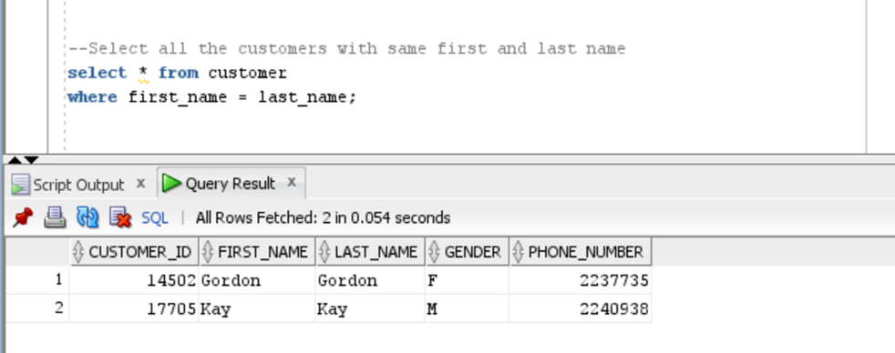
QUERIES
1. Total rows in customers and bookings tables (ensuring at least two tables have atleast 10,000 rows)
2. All the Customers with Same First and Last Name

Slide 16
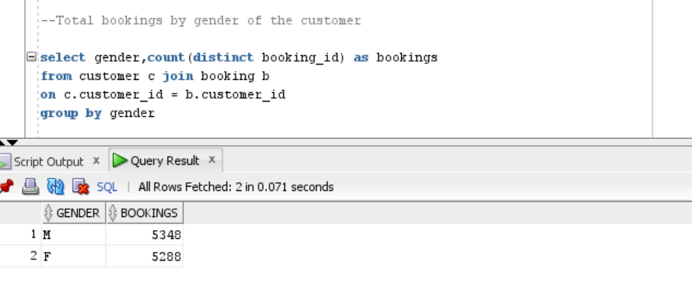
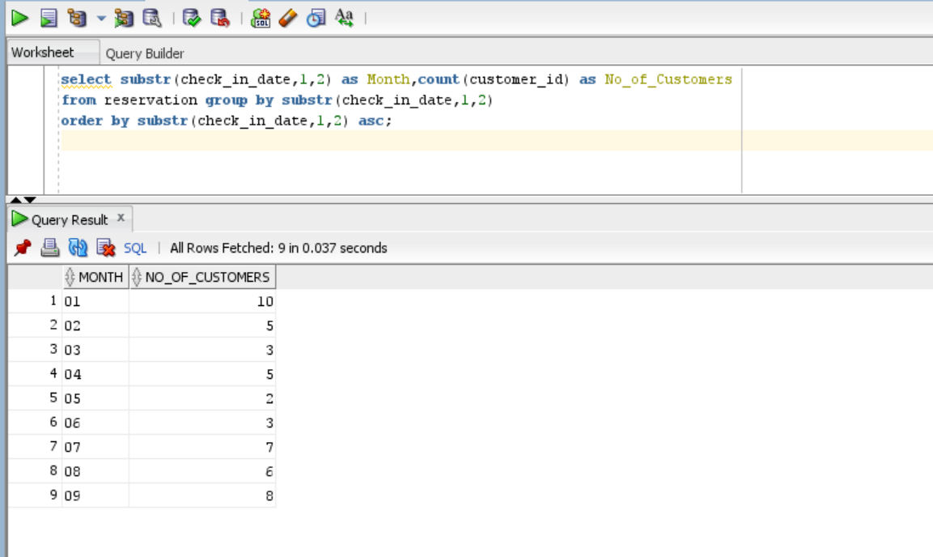
3. Total bookings by gender of the customer
4. Get the total number of customers per month.

Slide 17
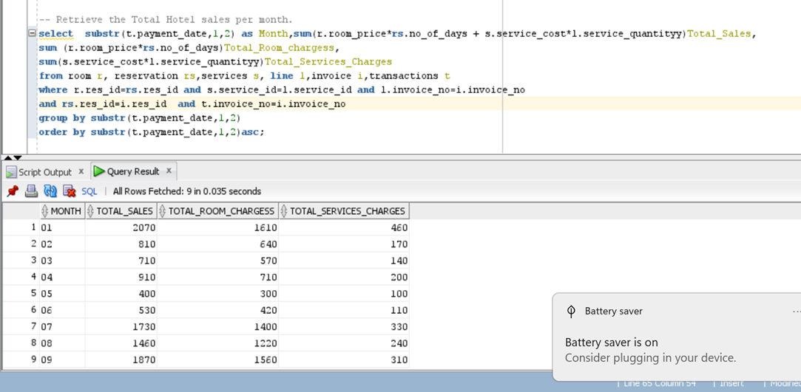
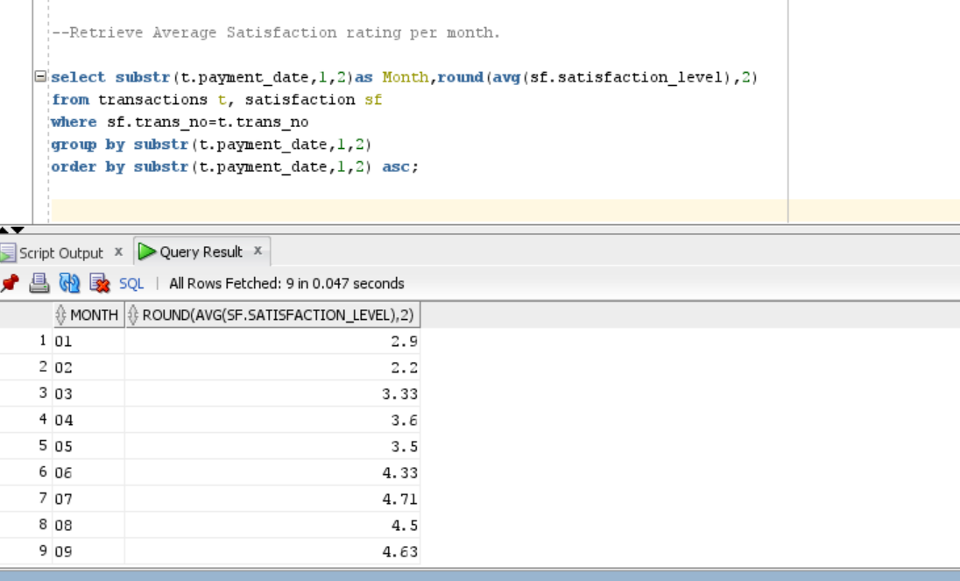
5. Retrieve the Total Hotel sales per month.
6. Fetch average satisfaction rating per month

Slide 18
Performance Tuning
INDEX : An index is used to increase the overall performance of queries. Indexing does this by reducing the data pages that has to be visited or scanned every time a query is run.
Query
In below example we can run a range query on two same tables, of which one table having primary key(Reservation) and other test table(Reservation_test) without primary key.
Reservation_test Table:-
Hql:-
CREATE TABLE Reservation_test (
Res_id number,
check_in_date varchar(20),
check_out_date varchar(20),
No_of_days number,
Customer_id number ,
Booking_id INTEGER
);

Slide 19
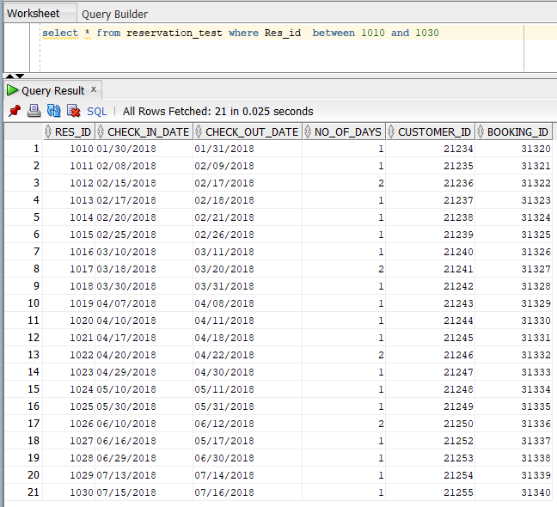
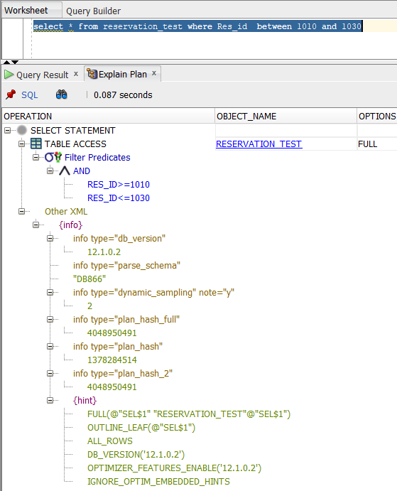
Query Result:-
Execution Plan:

Slide 20
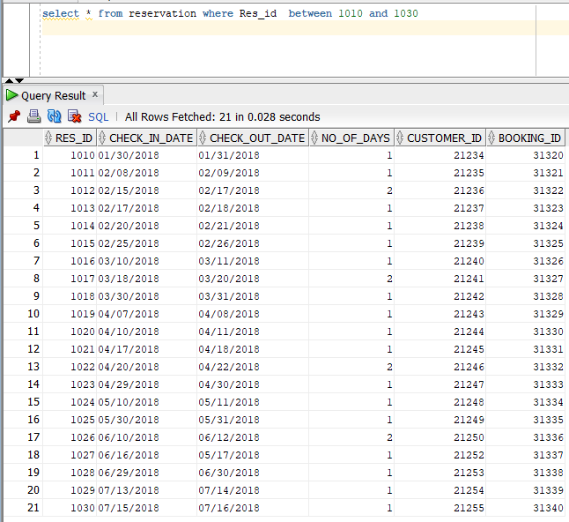
Reservation Table:-
CREATE TABLE Reservation (
Res_id number NOT NULL primary key,
check_in_date varchar(20),
check_out_date varchar(20),
No_of_days number,
Customer_id number ,
Booking_id INTEGER,
FOREIGN key(customer_id) references customer,
FOREIGN key(booking_id) references booking
);
Query Result:-

Slide 21
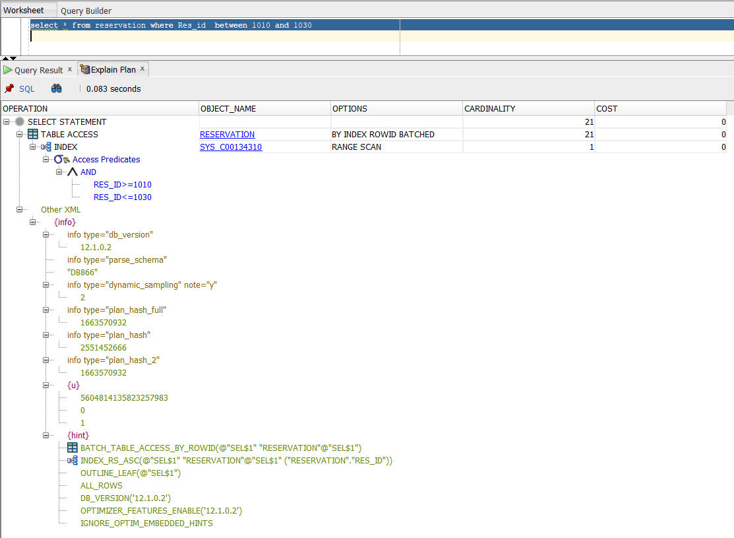
Execution Plan:
Better performance of query when table is created with primary key as it creates clustered index as default and indexing reduces the data pages that has to be visited or scanned every time a query is run

Slide 22
Reservation Table:-
Query Result:-
CREATE TABLE Reservation (
Res_id number NOT NULL primary key,
check_in_date varchar(20),
check_out_date varchar(20),
No_of_days number,
Customer_id number ,
Booking_id INTEGER,
FOREIGN key(customer_id) references customer,
FOREIGN key(booking_id) references booking
);

Slide 23
Execution Plan:
From the above screenshot we can see the better performance of query when table is created with primary key as it creates clustered index as default and indexing reduces the data pages that has to be visited or scanned every time a query is run

Slide 24
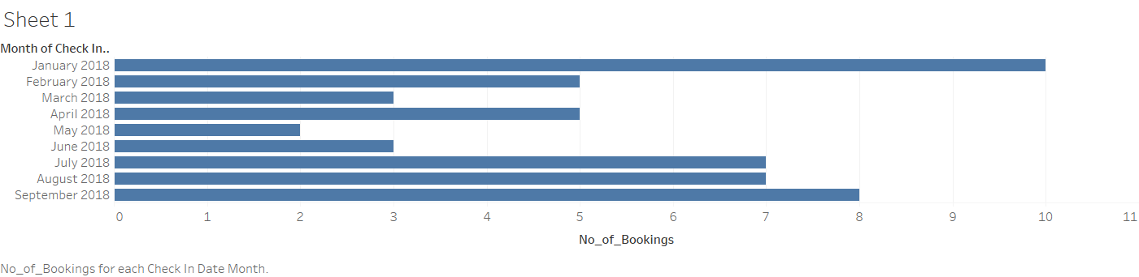
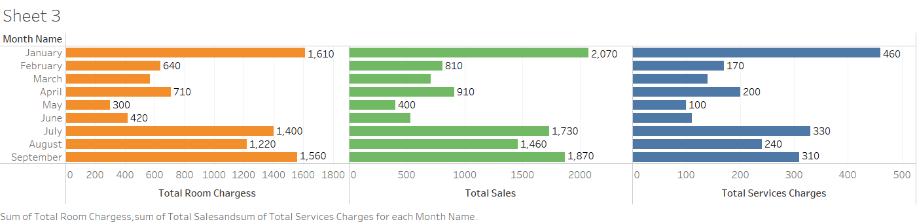
Visualization in Tableau
Dashboard 1:
Dashboard 1 includes visualizations which show
Get the total number of customers per month.
Dashboard 2:
Dashboard 2 includes visualizations which show:
Total Room Charges Vs Month
Total Sales Vs Month
Total Service Charges Vs Month

Slide 25
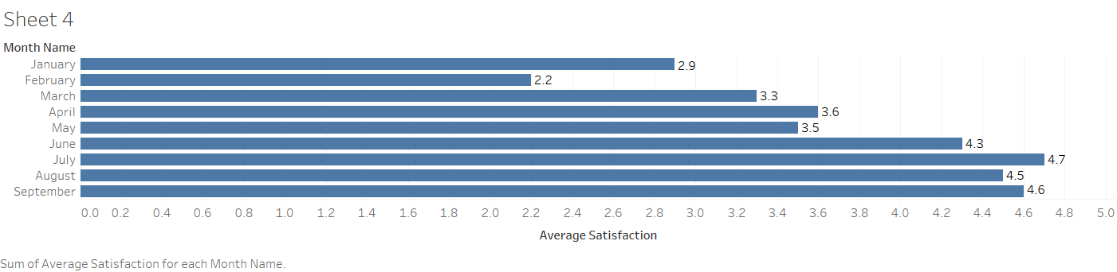
Dashboard 3:
Dashboard 3 includes visualizations which show:
Future Scope
The database can be utilized further to do the following analysis:
Sales Predictor:
We can use Multiple linear regression on the Room, Reservation. services, Line details data and predict sales of each month or year with data collected in future.
Foot Falls Predictor:
With more historical data of Reservation using linear regression, in future we can predict the expected no of customers to book hotel so that the hotel can be equipped ahead of demand.

Slide 26
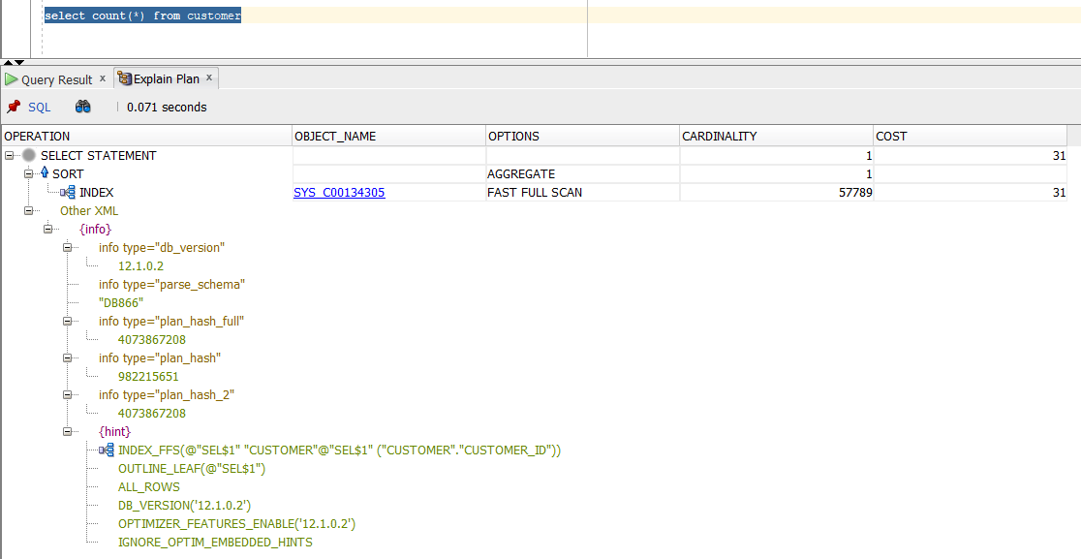
OTHER TOPICS:
Step 1:- Explain plan for count of customer table without parallel execution.

Slide 27
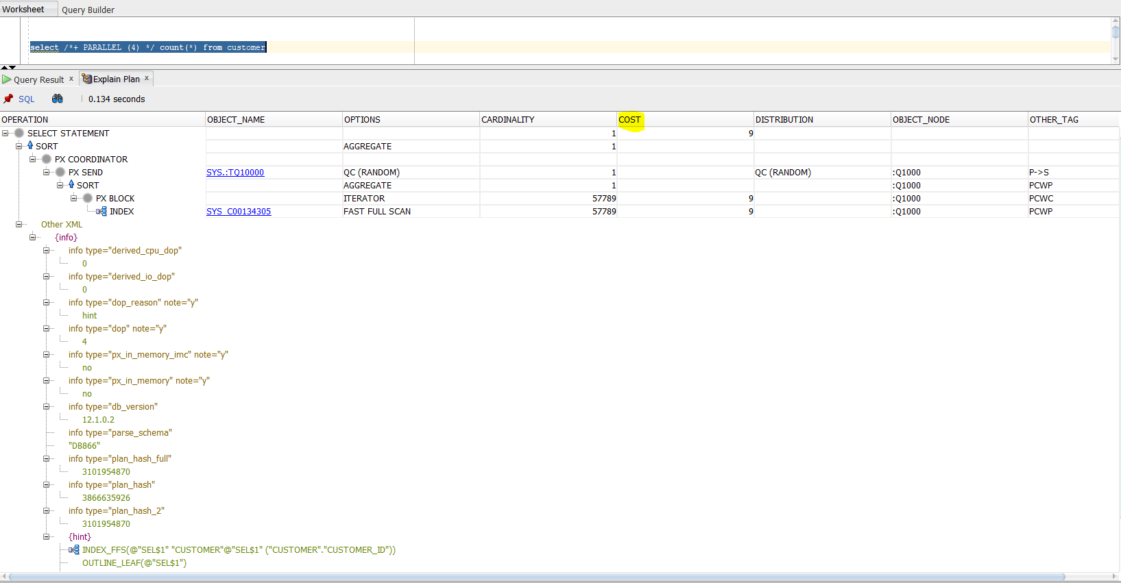
Step 2:- Now we are running same query triggering parallelism,4 different machines in this case. Let’s see the cost.
Parallel execution divides the task of executing a SQL statement into multiple small units, each of which is executed by a separate process. Also the incoming data (tables, indexes, partitions) can be divided into parts

Slide 28
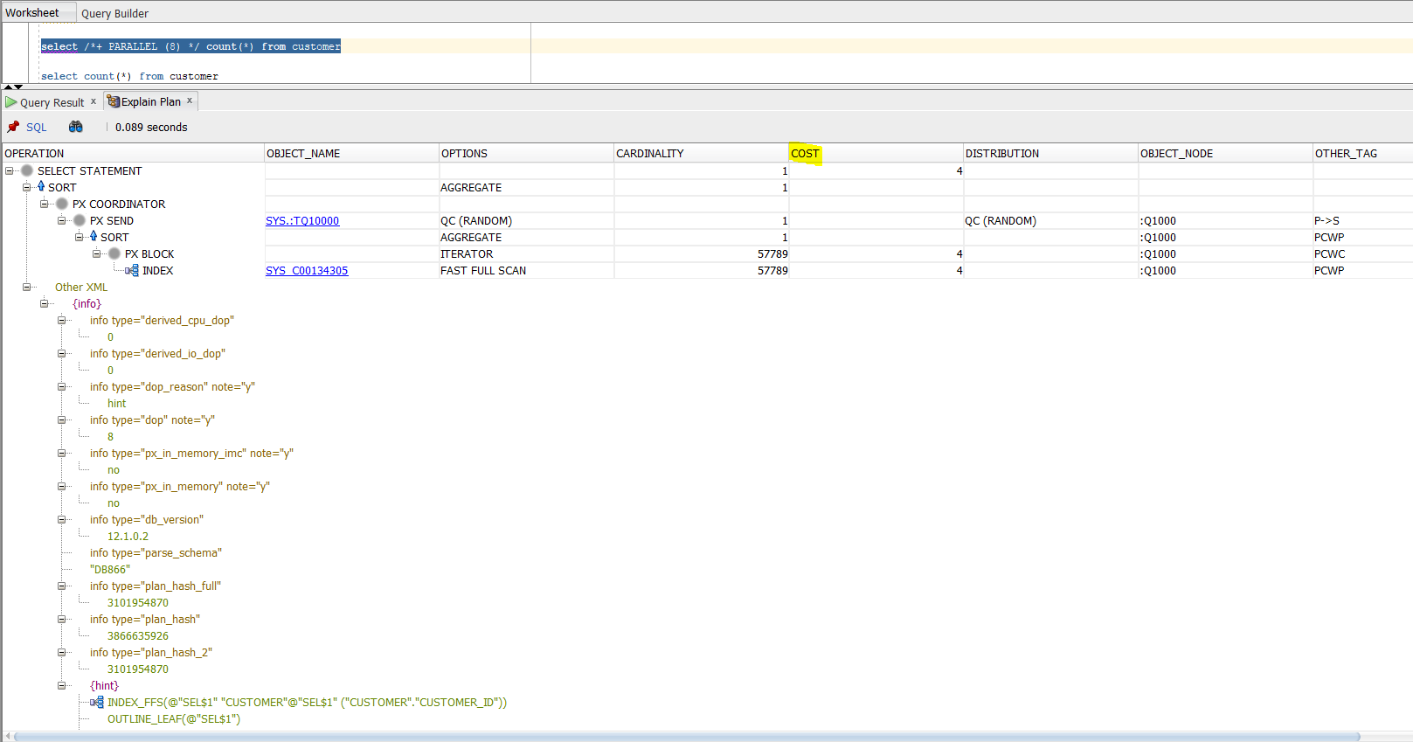
Step 3:-
Again running the same query triggering parallelism, 8 different machines in this case. Explain plan result
Results : - From the above results we can observe above that the cost has decreased everytime we increase the processes. As we know that parallelism is breaking down a task so that, instead of one process doing all of the work in a query, many processes do part of the work at the same time.
This can be observed in our results i.e cost reduction. This is very useful when we are dealing with online transaction processing (OLTP) and also dealing very huge scale data.

Slide 29
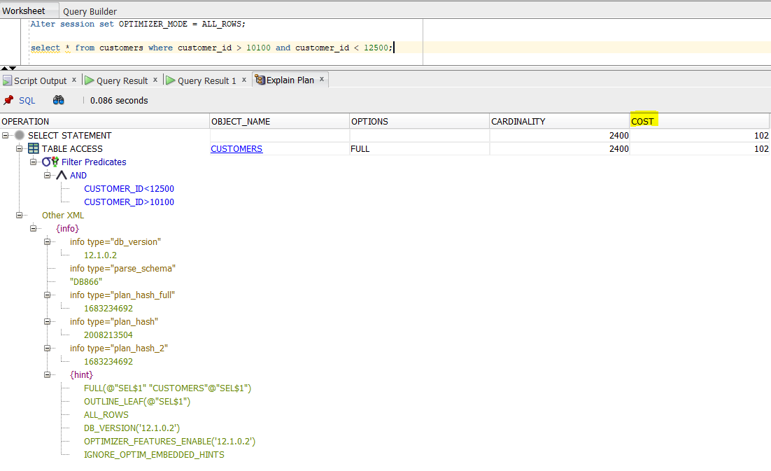
OPTIMIZER MODEL
( Using the Cost-Based Approach )
Optimizer mode is used to choose better execution plans for poorly written queries.
There are different types of optimizer modes in oracle such as ALL_ROWS, FIRST_ROWS_N, RULE, CHOOSE.
Here we check cost of simple range query with two optimizer modes. They are default ALL_ROWS and FIRST_ROWS_N.
Step1:- Optimizer used a cost-based approach for all SQL statements in the session and try best execution plan. Executing the query when the optimizer mode is ALL_ROWS.

Slide 30
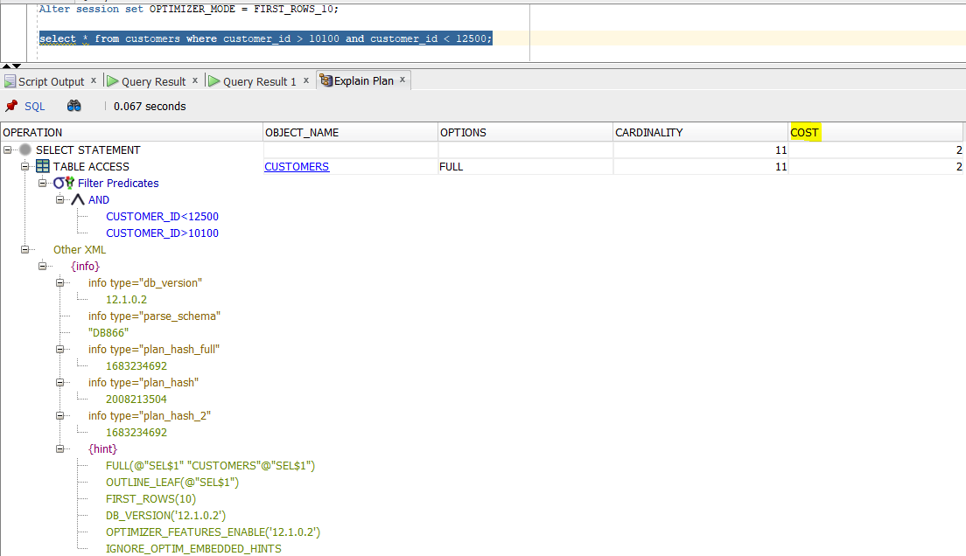
Step 2:- Optimizer uses a cost-based approach according to response time of the return the first n rows. Now altering the session to FIRST_ROWS_10 and examining the explain plan.
We cannot see much of time difference in execution of queries. However, when we compare the costs of two optimizer modes there is significant difference.
The cost when optimizer mode is ALL_ROWS is 102, whereas when the optimizer mode is FIRST_ROWS_10 it is 2.

Slide 31
References:
Data Source:
Tableau Tutorial: https://help.tableau.com/current/guides/get-started-tutorial/en-us/get-started-tutorial-home.htm

Slide 32


